Slide 1
Module 3 Cryptographic Mechanisms in Windows
Section 1 – Cryptographic APIs
June 2018

Slide 2
.
Part 1 – DPAPI and DPAPI-ng
Learning Objectives:
Know the services provided by these 2 APIs
Understand the architecture of DPAPI
Understand DPAPI-ng enhancements

Slide 3
DPAPI
Introduced in Microsoft Windows 2000
Data Protection API (DPAPI) is a pair of function calls that provide operating system-level data protection services to user and system processes
DPAPI is a password-based data protection service. It requires a password to provide protection
uses the user's logon password for protection

Slide 4
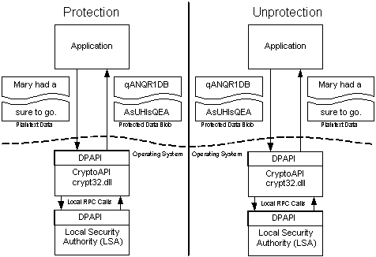
DPAPI Architecture
protected data BLOB is an opaque structure :
encrypted data
DPAPI meta-data
DPAPI does not store any of the protected data
Applications calling DPAPI must implement their own storage of the protected data
When an application calls one of the DPAPI functions, the functions make a local RPC call to the Local Security Authority (LSA)

Slide 5
DPAPI Keys and Passwords
DPAPI uses a key derived from user’s password
DPAPI also allows an application to use an additional secret when protecting data. This additional secret is then required to unprotect the data
Preventing applications stealing other applications secrets
Additionally, the application can pass in a data structure that will be used by DPAPI to prompt the user. This "prompt structure" allows the user to specify an additional password for this particular data.

Slide 6
Master Keys
DPAPI initially generates a strong key called a MasterKey, which is protected by the user's password.
MasterKey is not used explicitly to protect the data.
A symmetric session key is generated based on the MasterKey, some random data, and any additional entropy
DPAPI stores the random data it used to generate the key in the opaque data BLOB.
When the data BLOB is passed back in to DPAPI, the random data is used to re-derive the key and unprotect the data.

Slide 7
Master key lifetime
MasterKeys will expire (3 months)
A new MasterKey is generated and protected in the same manner.
This expiration prevents an attacker from compromising a single MasterKey and accessing all of a user's protected data.
DPAPI does not delete any expired MasterKeys
They are kept forever in the user's profile directory
DPAPI stores the Globally Unique Identifier (GUID) of the MasterKey used to protect the data in the opaque data BLOB that is returned to applications.

Slide 8
Master keys and password changes
DPAPI hooks into the password-changing module
When a user's password is changed, all MasterKeys are re-encrypted under the new password
DPAPI keeps a "Credential History" file in the user's profile directory
When a user changes his or her password, the old password is added to the top of this file and then the file is encrypted by the new password.
If necessary, DPAPI will use the current password to decrypt the "Credential History" file and try the old password to decrypt the MasterKey.
If this fails, the old password is used to again decrypt the "Credential History" file and the next previous password is then tried.

Slide 9
DPAPI key backup
When a computer is a member of a domain, DPAPI has a backup mechanism
Domain Controllers have a domain-wide public/private key pair, associated solely with DPAPI
The local DPAPI client gets the Domain Controller public key from a Domain Controller by using a mutually authenticated and privacy protected RPC call.
The client encrypts the MasterKey with the Domain Controller public key. It then stores this backup MasterKey along with the MasterKey protected by the user's password.

Slide 10
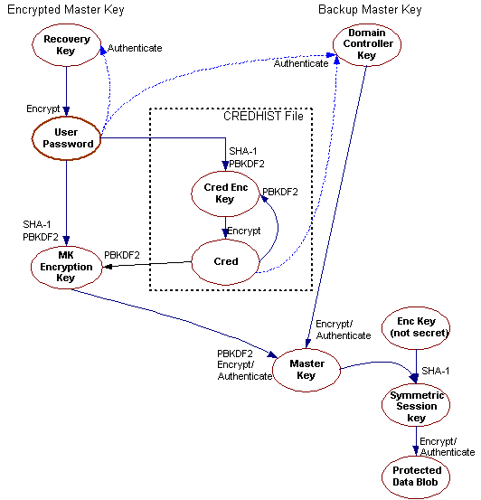
Key relationships
Recovery key only for standalone machines
Master Key is just random bytes
User’s password -> SHA-1 -> PBKDF2 => Master Key Encryption Key

Slide 11
Master key encryption key details
1. DPAPI takes the user's password and passes it through SHA-1 to get a password hash.
2. password hash is provided to the PBKDF2 function, along with sixteen random bytes for a salt + an iteration count
PBKDF2 function calls an additional function a number of times, specified by the iteration count, to derive a key from the given data. DPAPI uses SHA-1 for that underlying function.Iteration count is 4000.
HKEY_LOCAL_MACHINE\Software\Microsoft\Cryptography\Protect\Providers\GUID\MasterKeyIterationCount can change default value
3. Resulting value is hashed with an HMAC.
DPAPI again uses SHA-1 for the HMAC and the user's password + salt to derive the HMAC key.
4. Master key and its HMAC are both encrypted with value from (2) using 3-DES

Slide 12
Master key encryption algorithm changes
Starting from Windows 7
3-DES is replaced by AES-256
SHA1 is replaced by SHA2-512
Except for the primary password derivation which stays SHA-1

Slide 13
Session key details
The session key is the real symmetric key that is used for encrypting and decrypting the application data.
16 bytes of random data are generated and then hashed, by using SHA-1, with the MasterKey
This hash is then appended with the optional entropy and optional user password, mentioned earlier, by using CryptHashData()
The result is then passed to CryptDeriveKey() which derives and returns the session key

Slide 14
CNG DPAPI
DPAPI introduced in Windows 2000.
The API consists of two functions, CryptProtectData and CryptUnprotectData.
DPAPI is part of CryptoAPI and was intended for developers who knew very little about using cryptography.
Cloud computing, however, often requires that content encrypted on one computer be decrypted on another.
Therefore, beginning with Windows 8, Microsoft extended the idea of using a relatively straightforward API to encompass cloud scenarios.
This new API, called DPAPI-NG, enables you to securely share secrets (keys, passwords, key material) and messages by protecting them to a set of principals that can be used to unprotect them on different computers after proper authentication and authorization.

Slide 15
DPAPI -> CNG DPAPI
CryptProtectData -> NCryptProtectSecret
CryptUnprotectData -> NCryptUnprotectSecret

Slide 16
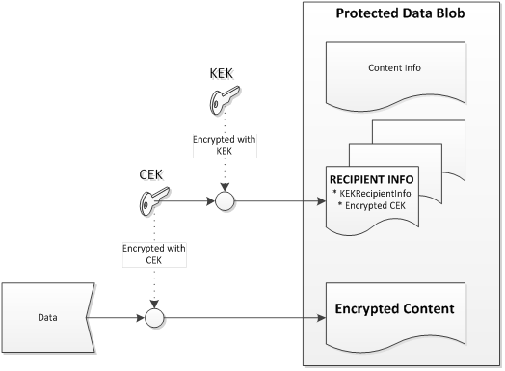
Protected data format
Protected data is stored as an ASN.1 encoded BLOB.
The data is formatted as CMS (certificate message syntax) enveloped content. The digital envelope contains
encrypted content
recipient information that contains an encrypted content encryption key (CEK),
a header that contains information about the content, including the unencrypted protection descriptor rule string.

Slide 17
Protection Descriptors
Use with NCryptCreateProtectionDescriptor
Protection descriptors can currently be defined for the following types of authorization:
A group in an Active Directory forest.
A set of web credentials.
A certificate.
Examples of protection descriptor rule strings for an Active Directory group include the following:
"SID=S-1-5-21-4392301 AND SID=S-1-5-21-3101812"
"SDDL=O:S-1-5-5-0-290724G:SYD:(A;;CCDC;;;S-1-5-5-0-290724)(A;;DC;;;WD)"
"LOCAL=user"
"LOCAL=machine"
Examples of protection descriptor rule strings for a set of web credentials include the following:
"WEBCREDENTIALS=MyPasswordName"
"WEBCREDENTIALS=MyPasswordName,myweb.com"
Examples of protection descriptor rule strings for a certificate include the following:
"CERTIFICATE=HashID:sha1_hash_of_certificate"
"CERTIFICATE=CertBlob:base64String"

Slide 18
.
Part 2 – Cryptography Next Generation (CNG) & CryptoAPI (CAPI)
Learning Objectives:
Understand how cryptography is provided to applications in Windows
Undertsand how the Windows cryptography APIs work

Slide 19
Windows cryptography frameworks
CAPI – Cryptographic Application Programming Interface
The first crypto framework in Windows. Introduced in Windows NT4
Enables developers to secure Windows-based applications using cryptography
Isolates developers from the code used to perform cryptographic operations
CNG – Cryptography API: Next Generation
Take the same design principles as CAPI. No disruption
Long-term replacement for CAPI. CNG is designed to be extensible at many levels and cryptography agnostic in behavior
CNG is supported beginning with Windows Server 2008 and Windows Vista

Slide 20
About Cryptography
At any time, cryptography will ensure one or more of these objectives:
Confidentiality : Keep the content understandable only by designated peers
Integrity : Ensure the content was not modified during transport
Authenticity : Ensure that emitters are really who they claim they are. Also provides non-repudiation

Slide 21
Cryptographic API

Slide 22
Cryptographic API
CryptoAPI and CAPICOM provide services that enable developers to add security based on cryptography to applications.
CryptoAPI includes functionality for
encoding to and decoding from Abstract Syntax Notation One (ASN.1)
encrypting and decrypting data
authentication using digital certificates
digital certificate management using certificate stores

Slide 23
Crypto API and Confidentiality
To achieve confidentiality, users must prevent anyone except the intended recipient from reading a message. Cryptographic techniques are used to encrypt (scramble) messages before the messages are stored or transmitted.
Developers can use CryptoAPI to encrypt and digitally sign data in a flexible manner, while helping to provide protection for the user's sensitive private key data.

Slide 24
Crypto API and Integrity
Any data sent over a non-secure media can be changed either by accident or on purpose. In the real world, seals are used to provide and prove integrity.
Integrity is provided in CryptoAPI by means of using Digital Signatures and Data Hashes.
CryptoAPI supports integrity through the use of message functions to sign data and to verify digital signatures.

Slide 25
Crypto API and Authenticity
Secure communications require that the individuals communicating know the identity of those with whom they communicate. Authentication is the process of verifying the identity of a person or entity.
CryptoAPI provides functions for signing data and verifying signatures by using public/private key pairs or, through the use of digital certificates, with certificate encode/decode functions, and certificate store functions.

Slide 26
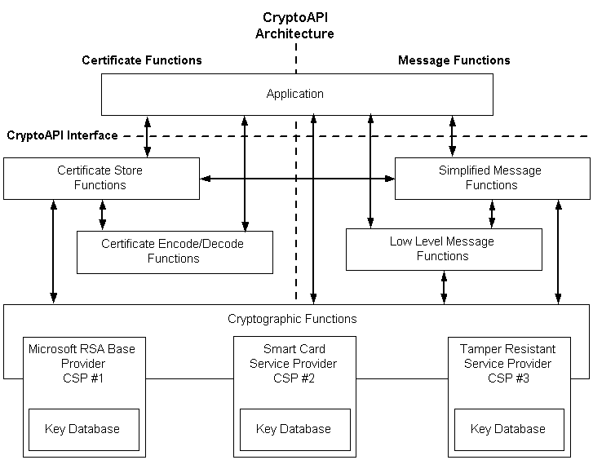
CryptoAPI System Architecture
The CryptoAPI system architecture is composed of five major functional areas:
Base Cryptographic Functions
Data Encryption and Decryption Functions
Certificate Store Functions
Simplified Message Functions
Low-level Message Functions

Slide 27
Cryptographic Service Providers
CryptoAPI functions use cryptographic service providers (CSPs) to perform encryption and decryption, and to provide key storage and security.
CSPs are independent modules.
CSPs are written to be independent of a particular application, so that any application will run with a variety of CSPs.
The access that applications have to the cryptographic internals is carefully restricted. This facilitates secure and portable application development.
At a minimum, a CSP consists of a dynamic-link library (DLL)
Some CSPs can implement a fraction of their functionality in an address-separated service called through local RPC or in hardware called through a system device driver.

Slide 28
Crypto API design rules
The following three design rules apply:
Applications cannot directly access keying material
Because all keying material is generated within the CSP and used by the application through opaque handles, there is low risk of an application or its associated DLLs either divulging keying material or choosing keying material from poor random sources.
Applications cannot specify the details of cryptographic operations
The CSP interface allows an application to choose an encryption or signature algorithm, but the implementation of every cryptographic operation is done by the CSP.
Applications do not handle user credentials or other user authentication data
User authentication is done by the CSP; therefore, future CSPs with advanced authentication capabilities will function without needing to change the application authentication model.

Slide 29
Developper point of view
Example : Developer creating a sha1RSA signature:
Call CryptAcquireContext() to instantiate the CSP
Call CryptCreateHash() to create a hash object
Call CryptHashData() to actually hash the data
Call CryptSignHash() to sign the hash

Slide 30
Microsoft Cryptographic Service Providers (1/2)
Provider
Microsoft Base Cryptographic Provider | A broad set of basic cryptographic functionality that can be exported to other countries or regions.
Microsoft Strong Cryptographic Provider | An extension of the Microsoft Base Cryptographic Provider available with Windows XP and later.
Microsoft Enhanced Cryptographic Provider | Microsoft Base Cryptographic Provider with through longer keys and additional algorithms.
Microsoft AES Cryptographic Provider | Microsoft Enhanced Cryptographic Provider with support for AES encryption algorithms.
Microsoft DSS Cryptographic Provider | Provides hashing, data signing, and signature verification capability using the Secure Hash Algorithm (SHA) and Digital Signature Standard (DSS) algorithms.

Slide 31
Microsoft Cryptographic Service Providers (2/2)
Provider
Microsoft Base DSS and Diffie-Hellman Cryptographic Provider | A superset of the DSS Cryptographic Provider that also supports Diffie-Hellman key exchange, hashing, data signing, and signature verification using the Secure Hash Algorithm (SHA) and Digital Signature Standard (DSS) algorithms.
Microsoft Enhanced DSS and Diffie-Hellman Cryptographic Provider | Supports Diffie-Hellman key exchange (a 40-bit DES derivative), SHA hashing, DSS data signing, and DSS signature verification.
Microsoft DSS and Diffie-Hellman/Schannel Cryptographic Provider | Supports hashing, data signing with DSS, generating Diffie-Hellman (D-H) keys, exchanging D-H keys, and exporting a D-H key. This CSP supports key derivation for the SSL3 and TLS1 protocols.
Microsoft RSA/Schannel Cryptographic Provider | Supports hashing, data signing, and signature verification. The algorithm identifier CALG_SSL3_SHAMD5 is used for SSL 3.0 and TLS 1.0 client authentication. This CSP supports key derivation for the SSL2, PCT1, SSL3 and TLS1 protocols.
Microsoft RSA Signature Cryptographic Provider | Provides data signing and signature verification.

Slide 32
About Cryptography Export Regulation
Historical cryptography export regulations required different restrictions on supported algorithms and key length
That’s the reason for having different CSPs for same algorithm family
These restrictions have now mostly been withdrawn
As of today some providers have different names but point to the same DLL

Slide 33
Microsoft CSP and their DLLs
Provider | DLL
Microsoft Base Cryptographic Provider v1.0 | rsaenh.dll
Microsoft Base DSS and Diffie-Hellman Cryptographic Provider | dssenh.dll
Microsoft Base DSS Cryptographic Provider | dssenh.dll
Microsoft Base Smart Card Crypto Provider | basecsp.dll
Microsoft DH SChannel Cryptographic Provider | dssenh.dll
Microsoft Enhanced Cryptographic Provider v1.0 | rsaenh.dll
Microsoft Enhanced DSS and Diffie-Hellman Cryptographic Provider | dssenh.dll
Microsoft Enhanced RSA and AES Cryptographic Provider | rsaenh.dll
Microsoft RSA SChannel Cryptographic Provider | rsaenh.dll
Microsoft Strong Cryptographic Provider | rsaenh.dll
See HKLM\SOFTWARE\Microsoft\Cryptography\Defaults\Provider

Slide 34
Base Cryptographic Functions
Context functions
Used to connect to a CSP.
These functions enable applications to choose a specific CSP by name or to choose a specific CSP that can provide a needed class of functionality
Eg. CryptAcquireContext , CryptEnumProviders, CryptGetDefaultProvider, CryptGetProvParam
See https://msdn.microsoft.com/en-us/library/windows/desktop/aa380252(v=vs.85).aspx#service_provider_functions
Key generation functions
Used to generate and store cryptographic keys.
Full support is included for changing chaining modes, initialization vectors, and other encryption features.
Eg. CryptDeriveKey, CryptDestroyKey, CryptDuplicateKey, CryptGenKey
See https://msdn.microsoft.com/en-us/library/windows/desktop/aa380252(v=vs.85).aspx#key_generation_and_exchange_functions
Key exchange functions
used to exchange or transmit keys
Eg. CryptExportKey, CryptImportKey

Slide 35
Data Encryption and Decryption Functions
Functions used to encrypt or decrypt data using a key
CryptDecrypt
Decrypts a section of ciphertext by using the specified encryption key.
CryptEncrypt
Encrypts a section of plaintext by using the specified encryption key.
Functions used to encrypt or decrypt data using DPAPI
CryptProtectData / CryptUnprotectData
Perform encryption/decryption of a blob
Take input blob and create a separate output blob
CryptProtectMemory / CryptUnprotectMemory
Perform encryption/decryption of a memory area
Diff. from CryptProtectData : Perform inplace encryption.

Slide 36
Certificate Store Functions
Functions used to manage collections of digital certificates
See https://msdn.microsoft.com/en-us/library/windows/desktop/aa380252(v=vs.85).aspx#certificate_store_functions
Common APIs
CertOpenStore : Opens a certificate store
CertEnumCertificatesInStore : Enumerates the certificate contexts in the certificate store.
CertFindCertificateInStore : Finds the first, or next, certificate context in the certificate store that meets a search criteria.
CertDeleteCertificateFromStore : Deletes a certificate from the certificate store.
Also includes revocation check APIs
See https://msdn.microsoft.com/en-us/library/windows/desktop/aa380252(v=vs.85).aspx#certificate_revocation_list_functions

Slide 37
Simplified Message Function
Wrap Low-level Message Functions into a single function to accomplish a more complex task.
Creating a PKCS #7 encrypted message
CryptEncryptMessage : Encrypts the message for the recipient or recipients.
CryptDecryptMessage : Decrypts the specified message.
Creating a PKCS #7 signed message
CryptSignMessage : Signs the message
Verifying a PKCS #7 signed message
CryptVerifyMessageSignature : Verifies a signed message

Slide 38
Low-level Message Functions
The low-level message functions provide more flexibility than the simplified message functions but require more function calls.
See https://msdn.microsoft.com/en-us/library/windows/desktop/aa380252(v=vs.85).aspx#low_level_message_functions
Eg. CryptMsgOpenToEncode , CryptMsgCountersign , CryptMsgClose , CryptMsgDuplicate

Slide 39
Certificate stores
Certificates, CRLs, and CTLs can be kept and maintained in certificate stores. They can be retrieved from a store where they have been persisted for use in the authentication processes.
Many kind of stores with different storage backends : files, memory, LDAP, pkcs#7 files, …

Slide 40
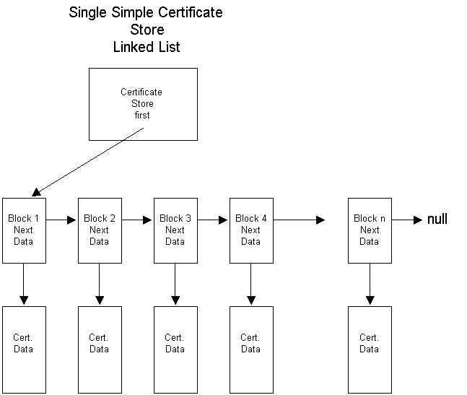
Certificate storage in stores
Each certificate store has a pointer to the first certificate block in that store.
A certificate block includes a pointer to that certificate's data and a "next" pointer to the next certificate block in the store.
The "next" pointer in the last certificate block is set to NULL.
The data block of a certificate contains the read-only certificate context and any extended properties of the certificate.
The data block of each certificate contains a reference count that keeps track of the number of pointers to the certificate that exist.

Slide 41
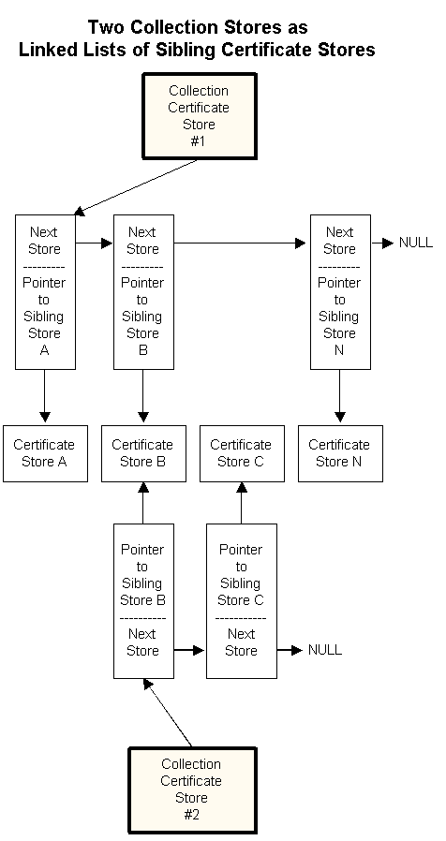
Collection Stores
A logical store and a collection certificate store are groups of physical stores that appear to an application as a single store.
All member stores of a logical or a collection store can be searched or enumerated with a single function call to either CertFindCertificateInStore or CertEnumCertificatesInStore.

Slide 42
Logical and Physical stores
Default system stores, including MY, CA, and ROOT, are implemented as logical collection stores with several predefined physical stores as their member stores.

Slide 43
Sample commands to work with certificate stores
Certutil -enumstore
All local stores
Certutil -enterprise -enumstore
All enterprise stores (local copies of Active Directory certificate stores)
Certutil -grouppolicy -enumstore
All machine GPO stores (stores embedded in GPO)
Certutil -user -grouppolicy -enumstore
All user gpo stores
Certutil -service -service -enumstore
All service stores

Slide 44
Stores location
Machine store
HKEY_LOCAL_MACHINE\SOFTWARE\Microsoft\SystemCertificates
User stores
HKEY_CURRENT_USER\Software\Microsoft\SystemCertificates
MY (==Personal) : %userprofile%\AppData\Roaming\Microsoft\SystemCertificates\My
Service stores
HKEY_LOCAL_MACHINE\SOFTWARE\Microsoft\Cryptography\Services\nom_du_service\SystemCertificates
Enterprise stores
HKEY_LOCAL_MACHINE\SOFTWARE\Microsoft\EnterpriseCertificates
Machine GPO stores
HKEY_LOCAL_MACHINE\SOFTWARE\Policies\Microsoft\SystemCertificates

Slide 45
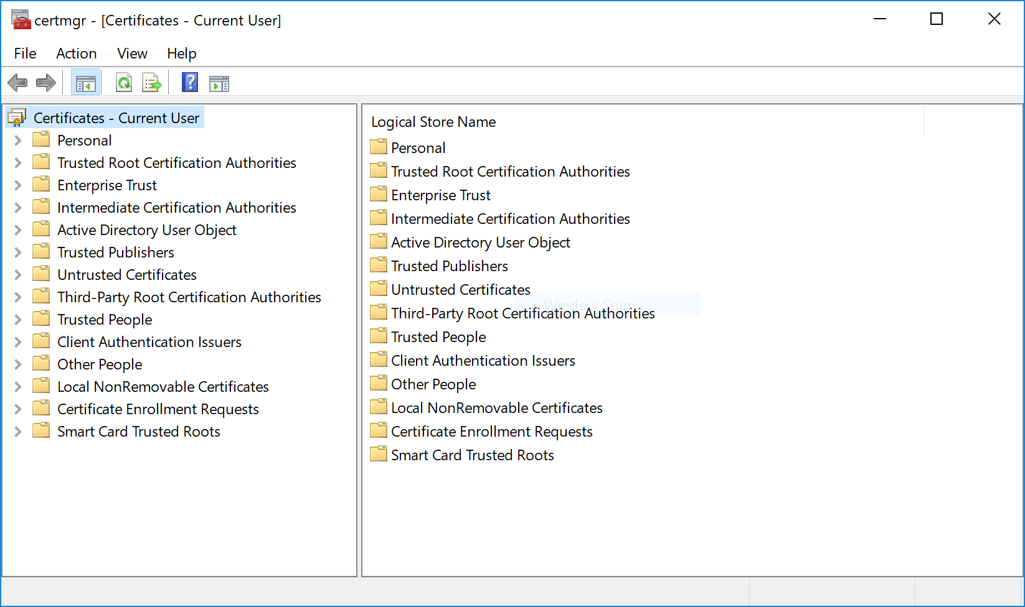
Displaying current user’s certificates with certmgr.msc
Starting with Win8.1/2012 R2, the same console exists for machines stores : certlm.msc
Console displays friendly names not real names

Slide 46
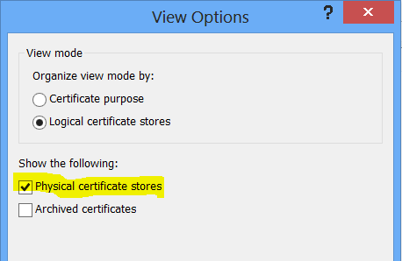
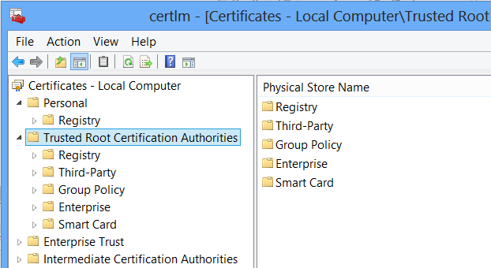
Displaying physical stores instead of logical store

Slide 47
Cryptographic API: Next Generation

Slide 48
What about CAPI
CAPI
APIs will live forever, as-is
No updates, other than MSRC fixes
CNG as CAPI1 backbone
Remove all crypto implementation from CAPI1
Call out to CNG primitives for all core crypto
Key management kept in CAPI
FIPS 140-2
Would not have to be separately certified

Slide 49
CAPI/CNG Architecture
Applications
CSP Router
KSP Router
RSAENH.DLL
NCRYPT.DLL
DSSENH.DLL
KSPs
CSPs
Bcrypt Router
Containers
Containers
Algorithm Providers
Containers

Slide 50
CNG – Cryptographic API: Next Generation
Cryptography API: Next Generation (CNG) is the long-term replacement for the CryptoAPI.
Takes the same design principles as CAPI.
CNG is designed to be extensible at many levels and cryptography agnostic in behavior.
CNG is supported beginning with Windows Server 2008 and Windows Vista.

Slide 51
CNG Features
Cryptographic Agility
Finer-grained abstraction for key storage (and separation of storage from algorithm operations).
Process isolation for operations with long-term keys.
Relief from export signing restrictions.
Kernel-mode cryptographic API.
Suite B support
Auditing support
Replaceable Random number generators
Thread safety

Slide 52
Suite B support
In February of 2005, the National Security Agency (NSA) of the United States announced a coordinated set of symmetric encryption, asymmetric secret agreement (also known as key exchange), digital signature and hash functions for future U.S. government use called Suite B.
CNG includes support for Suite B that extends to all required algorithms: AES (all key sizes), the SHA-2 family (SHA-256, SHA-384 and SHA-512) of hashing algorithms, ECDH, and elliptic curve DSA (ECDSA) over the NIST-standard prime curves P-256, P-384, and P-521.

Slide 53
Kernel Support
Driver Ksecdd.sys
CNG supports cryptography in kernel mode.
Both SSL/TLS and IPsec operate in kernel mode.
All CNG functions can be called from kernel mode if the caller is running at PASSIVE_LEVEL IRQL.
In addition, some kernel mode CNG functions may be callable at DISPATCH_LEVEL IRQL, depending on the provider's capabilities.

Slide 54
Auditing
Key and key-pair generation failures, including self-test failures.
Key import and export.
Key destruction failures.
Persistent keys need are audited when they are written to and read from files.
Pair-wise consistency check failures.
Secret key validation failures, if any, are audited, for example, parity checks on 3DES keys.
Failures in encryption, decryption, hashing, signature, verification, key exchange, and random number generation.
Cryptographic self-tests.
auditpol /set /subcategory:"other system events" /success:enable /failure:enable

Slide 55
.
Part 3 – Authenticode
Learning Objectives:
Understand how Windows implements code signing security
Understand how Authenticode help prevent running untrusted software
Know the deployable security features based on Authenticode

Slide 56
Code Signing
One of the larger questions facing the software industry is this: How can users trust code that is published on the Internet?
Two issues that must be addressed
Ensuring authenticity
Assures users that they know where the code came from.
Ensuring integrity
Verifies that the code hasn't been tampered with since its publication.
A solution to these issues is Microsoft Authenticode coupled with an infrastructure of trusted entities.

Slide 57
Authenticode from users & developers point of view
Authenticode is the mechanism by which users can be informed of whether the software publisher is participating in the infrastructure of trusted entities.
Authenticode serves the needs of both software publishers and users who rely upon the Internet for downloading software.

Slide 58
Technical overview
Authenticode is a digital signature format that relies on the PKCS#7 standard to provide a way to sign the executable code for supported file formats like PE files.
Distinction between code integrity and file integrity
Code integrity ensures that any modifications to executable code can be detected.
Different from file integrity. Not all the contents of a file may contain executable code and a file maybe modified without altering any of its executable code
Authenticode is a means of ensuring code integrity and not file integrity.

Slide 59
Code signing process
Code Signing process
A one-way hash of the executable code is produced.
The hash is encrypted with the private key, thereby signing the document.
The signed hash is embedded in the executable file and is transmitted to the final user.
Verification process
The recipient produces a one-way hash of the executable code.
Using the digital signature algorithm, the recipient decrypts the signed hash with the sender's public key.

Slide 60
Trusting signatures
Verifying code signature is only half the process
Authenticode also verifies that the developer’s certificate can be trusted
Historically, there were notions of commercial certificates vs. individual certificates.
Not true anymore
Commercial third-party CAs have their own assurance criterion before issuing code signing certificates
The CA/Browser form tries to uniformize such criterion between vendors (https://cabforum.org)

Slide 61
Signing certificate requirements
Technical requirement
Enhanced Key Usages OIDs
Code Signing : "1.3.6.1.5.5.7.3.3"
EKU is required. Signature is valid until certificate expires or, if signature is timestamped, is valid forever
Lifetime Code Signing : "1.3.6.1.4.1.311.10.3.13"
The default Authenticode policy is to treat all time stamped signatures as being valid forever. This OID limits the valid lifetime of the signature to the lifetime of the certificate. This allows timestamped signatures to expire. Normally this OID will be used in conjunction with Code Signing to indicate new time stamp semantics should be used.
Real Requirement
Due to recent security incident, CAs and Microsoft now enforces stronger requirements in identity verification and issuance constraints
https://docs.microsoft.com/en-us/windows-hardware/drivers/dashboard/get-a-code-signing-certificate

Slide 62
Authenticode helper applications
MakeCert, which creates a test X.509 certificate.
Cert2SPC, which creates a test software publishing certificate.
SignCode, which signs a file.
ChkTrust, which checks the validity of the file.
MakeCTL, which creates a certificate trust list.
CertMgr, which manages certificates, certificate trust lists, and certificate revocation lists.
SetReg, which sets registry keys that control the certificate verification process.
MakeCat, which creates a combined catalog of files.

Slide 63
Using authenticode to create white-listing policy on users’ machines
Historical technology : Software Restriction Policy
https://docs.microsoft.com/en-us/windows-server/identity/software-restriction-policies/software-restriction-policies
Not recommended for new deployments. Use AppLocker instead.
Recent technology : AppLocker
https://docs.microsoft.com/en-us/windows/security/threat-protection/windows-defender-application-control/applocker/applocker-overview
Starting with Windows 10 : Device Guard / Windows Defender Application Control
https://docs.microsoft.com/en-us/windows/security/threat-protection/windows-defender-application-control/windows-defender-application-control

